Slide 1
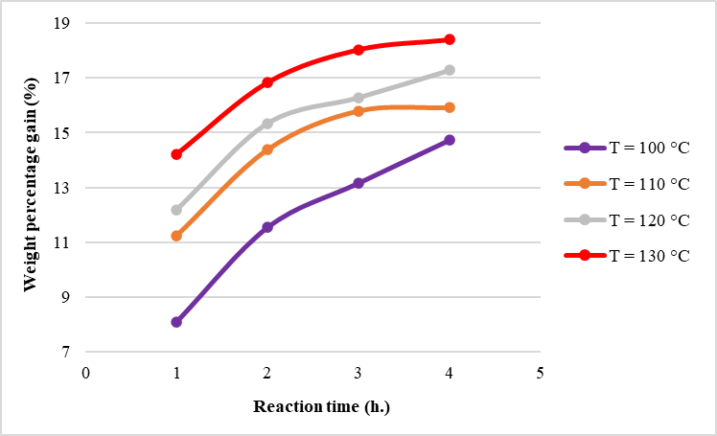
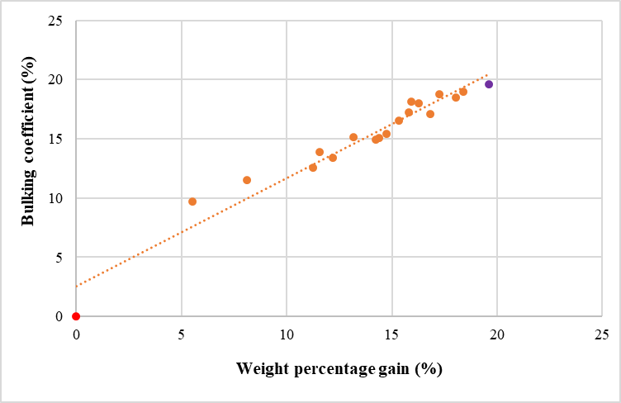
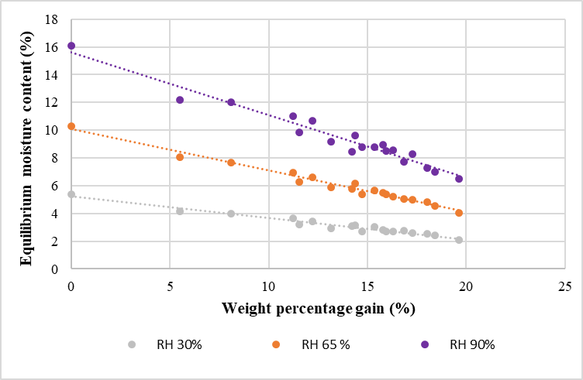
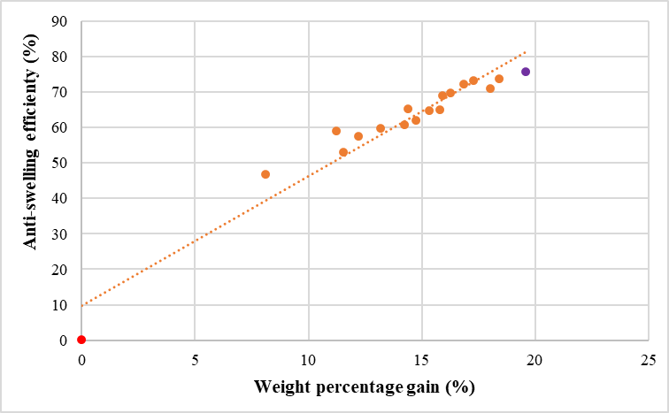
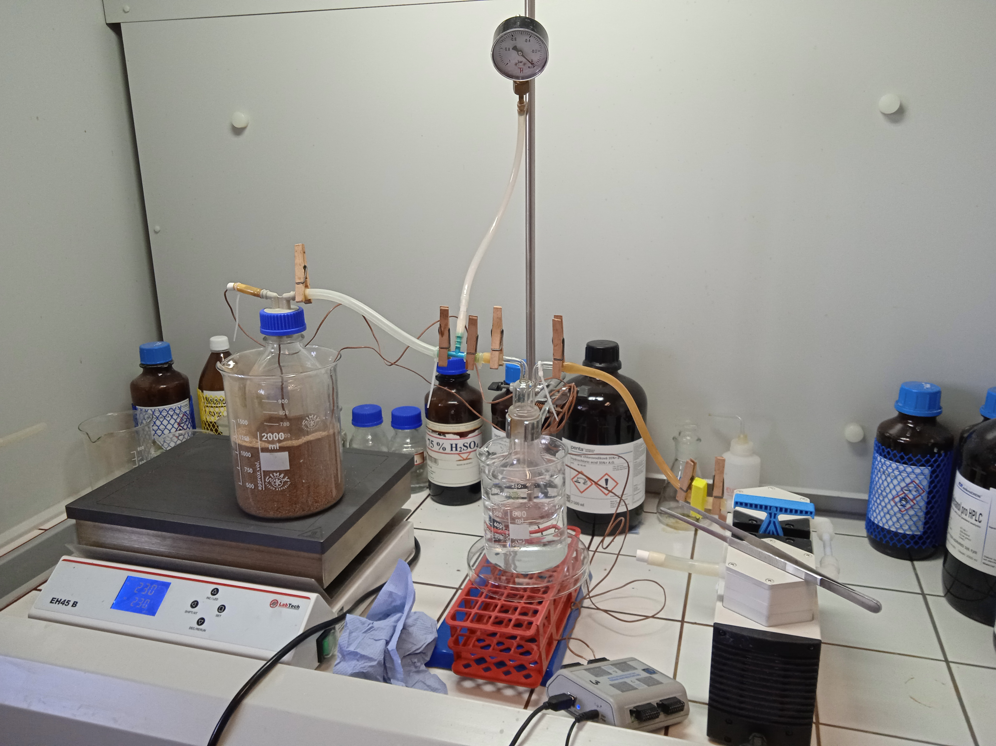
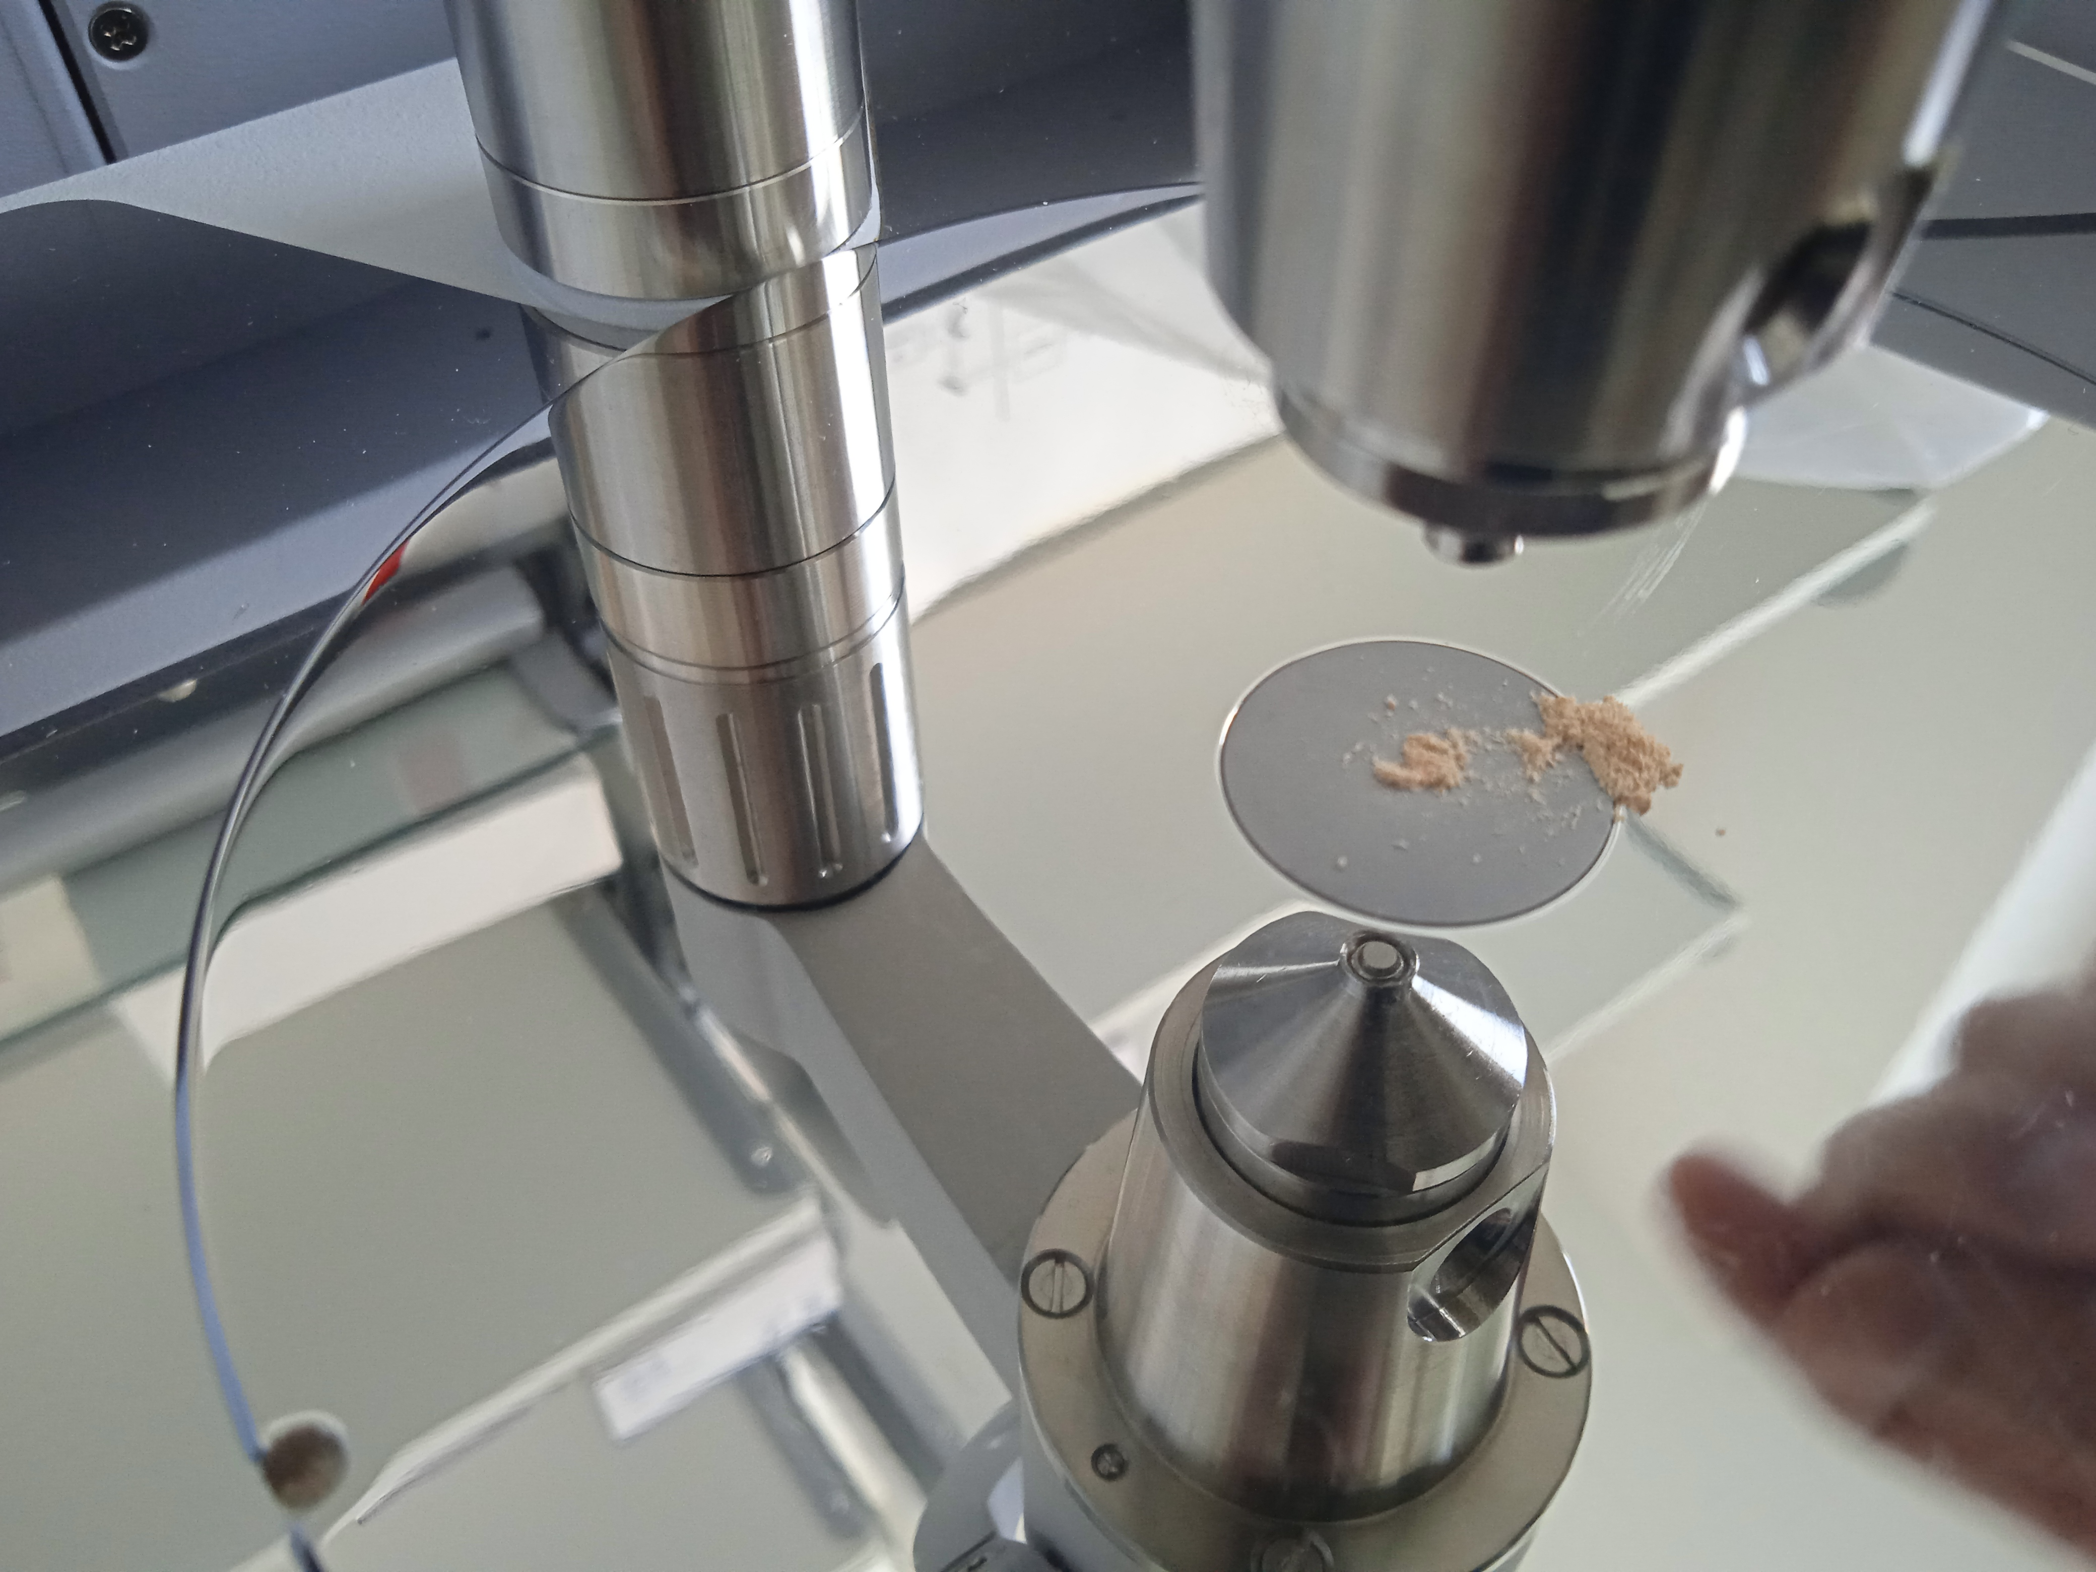
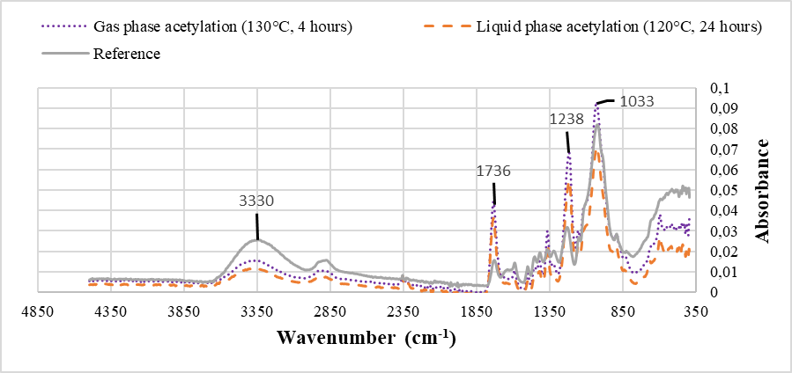
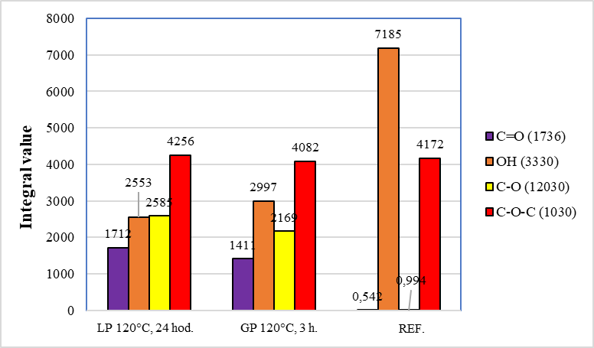
Comparison of wood acetylation methods with gas and liquid–phase chemicals Beránek Štěpán, Baar Jan Mendel University in Brno, Zemědělská 3, 613 00 Brno / Faculty of Forestry and Wood Technology e-mail: xberane2@mendelu.cz
GOAL:
The aim of the project was to compare the acetylation processes of European beech wood (Fagus sylvatica) depending on the different phases of acetic anhydride – gaseous and liquid. Furthermore, the properties of the acetylated samples were tested: Equilibrium moisture content (EMC) and Anti–swelling efficacy (ASE) and samples were analysis with Fourier Transform infrared spectroscopy (FTIR) in order to compare changes in the chemical composition of the samples.
Material & methods:
The examined beech samples were processed to dimensions of 20×20×20 mm. Acetylation in the liquid phase was carried out according to the procedure publish in Čermák et al. 2022. For acetylation in the gas phase, a vacuum distillation apparatus was created. Acetylated samples in gas phase tested with more extensive treatment parameters (temperatures of 100, 110, 120 and 130°C; and reaction times of 1, 2, 3 and 4 hours) versus acetylated samples in liquid phase.
Water related properties were tested both in terms of exposure to water vapor (in a climate chamber with different values of air humidity – 30, 65 and 90%) and in the case of soaking the samples in demineralized water (from period of 2 hours to 3 months).
Chemical analyzes were performed in collaboration with the Universität für Bodenkultur Wien (BOKU), Austria. The investigated method of FTIR analysis was Attenuated Total Reflexion (ATR), when the crushed wood dust of the samples was placed on the measuring device. After entering the range of measured values, a spectrum was created with individual absorption peaks for the investigated chemical bonds.
RESULTS:
Wood acetylation:
Water related properties:
FTIR analysis – ATR:
https://www.ldf.mendelu.cz/
Fig. 3 – weight percentage gain (WPG) of acetylated samples in the gas phase depending on temperature and reaction time.
Fig. 4 – relationship between the values of WPG and the bulking coefficient (BC) of gas acetylated (orange), liquid acetylated (purple) and reference (red) samples.
Fig. 5 – relationship between WPG and EMC of gas acetylated, liquid and reference samples (RH – relative humidity).
Fig. 6 – relanship between WPG and ASE of gas acetylated (orange), liquid acetylated (purple) and reference (red) samples after 720 hours soaking.
Fig. 1 – vacuum distillation apparatus
Fig. 2 – application of wood dust sample
Fig. 7 – FTIR - ATR spectrum with the individual investigated absorption peaks.
Fig. 8 – investigated absorption peaks (chemical bonds) according to individual methods of acetylation.
ACKNOWLEDGEMENT:
This research was financed by funds provided by Internal Grant Agency MENDELU (Project No. IGA- LDF-23-IP-035)

