Slide 1
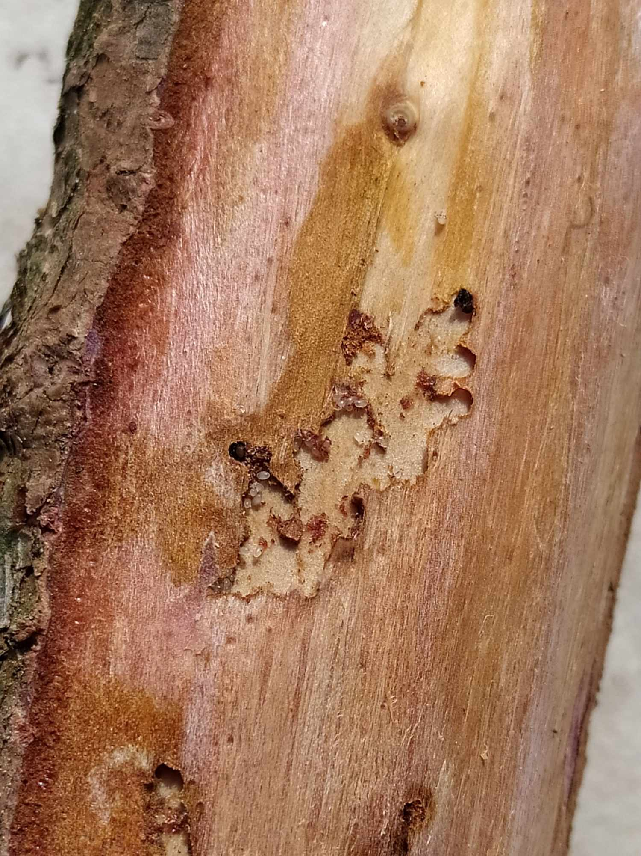
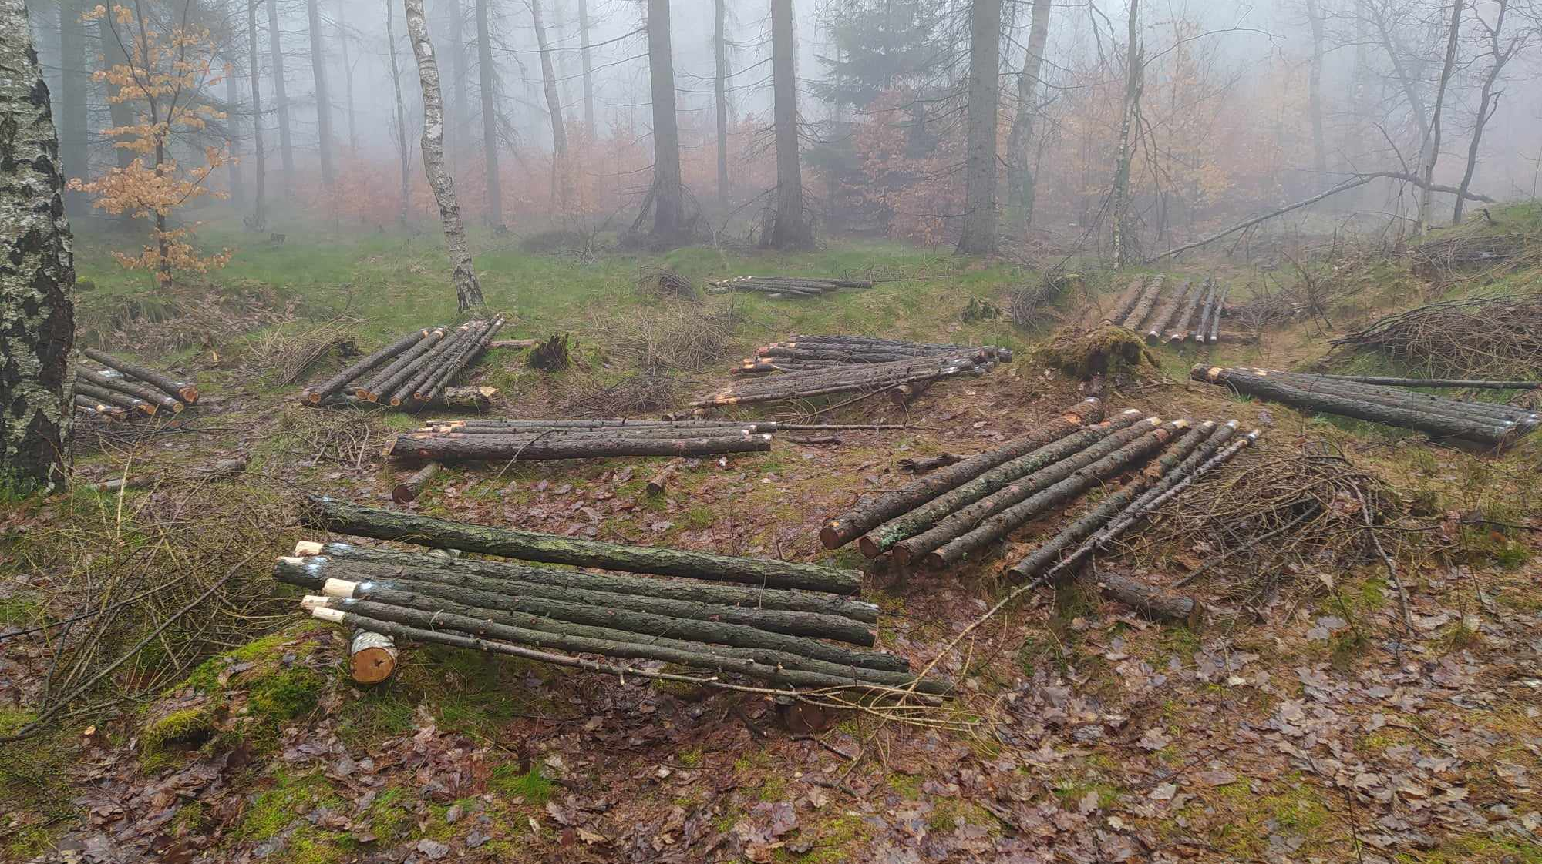
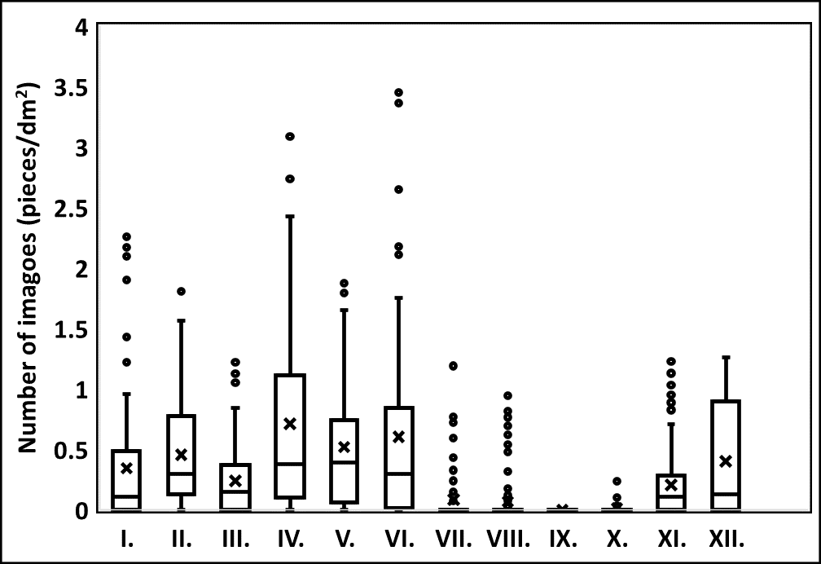
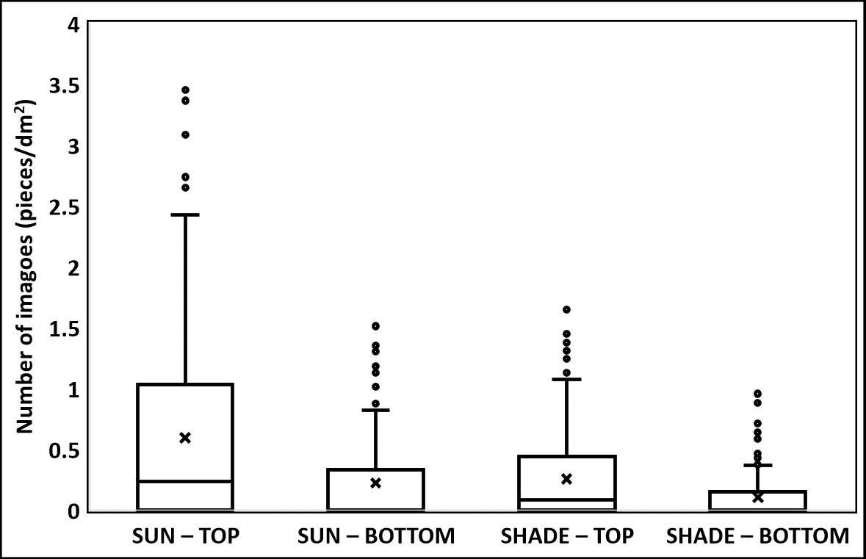
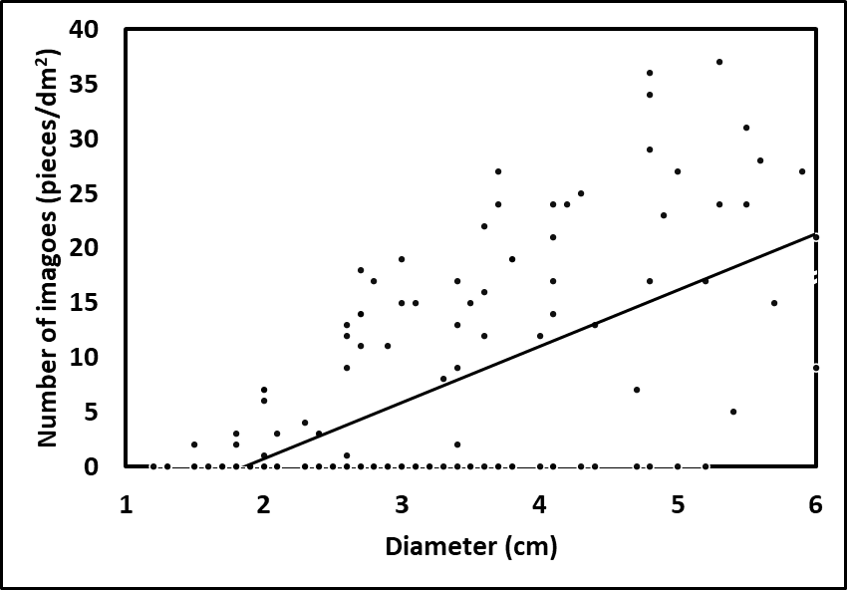
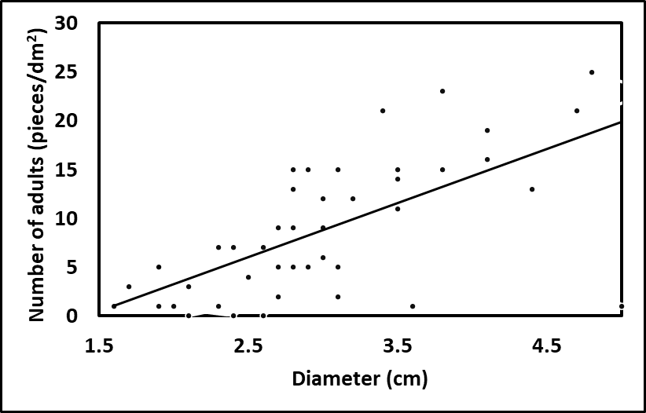
IMPACT OF LOGGING RESIDUES OF EUROPEAN LARCH ON BARK BEETLES AND ITS THREAT TO THE FOREST
Špoula Jakub, Kula Emanuel
Department of Forest Protection and Wildlife Management, Faculty of Forestry and Wood Technology, Mendel University in Brno
INTRODUCTION
METHODOLOGY
Pfeffer and Knížek [6] defined 11 species of Scolytinae that can infest European larch (Larix decidua). Compared to Pinus sylvestris L. (48 species) or Picea abies L. (39 species), the spectrum of bark beetles appears to be relatively poor. Only Ips cembrae Heer and Cryphalus intermedius Ferrari are monophagous on larch. Ips cembrae is one of several species of the genus Ips that naturally occur in Europe. It is the most important pest of European larch with recorded local outbreaks [2; 3; 4]. Cryphalus intermedius locally occurs in northern Moravia [5] and more rarely in Bohemia [1]. The aim of this study was to assess the bark beetle species that can breed in larch branches and residues from thinning.
On 3 model localities every month (from August 2022 to August 2023) 2 trees were felled. The trees were cutted into logs (length = 2 m). The logs from first tree were placed into forest stand and logs from second tree were placed on open area. After the infestation by I. cembrae, the logs were debarked in the centre (length = 0.5 m) and the numbers of nuptial chambers, maternal galleries, eggs, and stage of development were recorded. On 5 model localities, 2 piles of branches from larch were placed into forest stand and on open area. After the infestation, the branches were cutted into 0.5 m sections and analyzed for presence of bark beetles. The normality of data was analyzed by Shapiro–Wilk test and differences were tested by Mann–Whitney U test and Kruskal-Wallis H test (KW). Pearson correlation coefficient was used to determine the relationship between diameter and abundance of bark beetles.
Larch logs
C. intermedius gallery
RESULTS
In total, 5 777 imagoes of I. cembrae were recorded in logs. There were significant differences in the abundance of I. cembrae on logs felled in winter/spring and summer/autumn (KW: p < 0.00001) (Fig. 1). The highest infestation density was recorded on the top of logs placed in the open area (U: p = 00001) (Fig. 2).
Totally 321 infested sections from larch branches were analyzed. Three species of bark beetles (I. cembrae, C. intermedius and Pityogenes chalcographus) were recorded. Cryphalus intermedius was only recorded on the branches placed in the shade. Pityogenes chalcographus infested only the branches placed in vicinity of spruce monoculture forest and infested only 9.3 % of the branches. Positive correlation (r = 0.62) was found between the diameter of branch and I. cembrae infestation density (p = 0.001) (Fig. 3). Positive correlation (r = 0.68) was found between the diameter of branch and C. intermedius infestation density (p = 0.0001) too (Fig. 4).
Fig. 1: Numbers of I. cembrae adults captured on
logs felled in particular months
Fig. 2: Numbers of I. cembrae adults captured on
top/bottom of the logs
Fig. 3: Scatter plot of diameter of branches and
I. cembrae infestation density
Fig. 4: Scatter plot of diameter of branches and
C. intermedius infestation density
ACKNOWLEDGEMENT
This study was supported with funding provided by the Internal Grant Agency (IGA) project ‘IGA-FFWT-23-IP-017‘ of the Faculty of Forestry and Wood Technology, Mendel University in Brno.
REFERENCES
[1] Fiala, T., Knížek, M. 2020. Faunistic records from the Czech Republic. Coleoptera: Curculionidae: Scolytinae. Klapalekiana, 56, 266 pp.
[2] Gregoire, J.C., Evans, H.F. 2004. Damage and control of BAWBILT organisms – an overview. In: Lieutier, F., Day, K.R., Battisti, A., Gregoire, J.C., Evans, H.F. (eds.): Bark and Wood Boring Insects in Living Trees in Europe, a Synthesis. Dordrecht, Kluwer, 19–37.
[3] Grodzki, W., Kosibowicz, M. 2009. Contribution to the recognition of the biology of Ips cembrae (Heer) (Col., Curculionidae, Scolytinae) in the conditions of southern Poland. Sylwan, 153(9), 587–593.
[4] Krehan, H., Cech, T.L. 2004. Larch damage in Upper Styria. An example of the complex effects of damage agents. Forstschutz Aktuell, 32, 4–8.
[5] Pfeffer, A. 1989. Kůrovcovití a jádrohlodovití. Praha, Academia, 140 pp.
[6] Pfeffer, A. 1995. Zentral- und westpaläarktische Borken- und Kernkäfer (Coleoptera: Scolytidae, Platypodidae). Basel, Pro Entomologia, c/o Naturhistorisches
Museum, 310 pp.
https://www.ldf.mendelu.cz/

