Slide 1
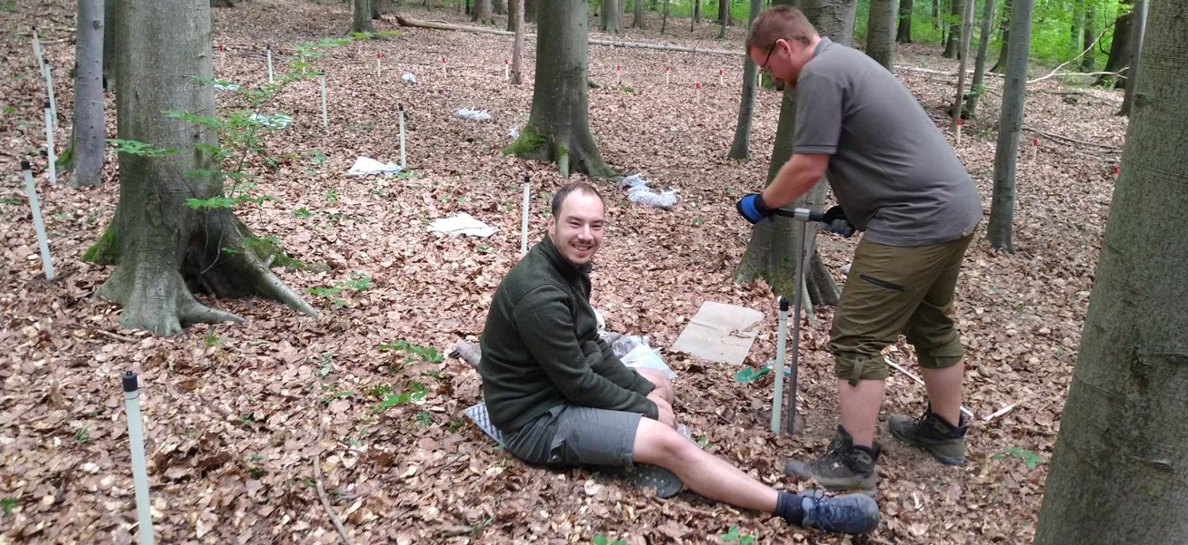
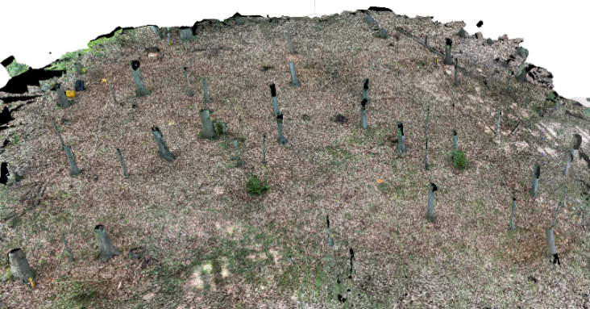
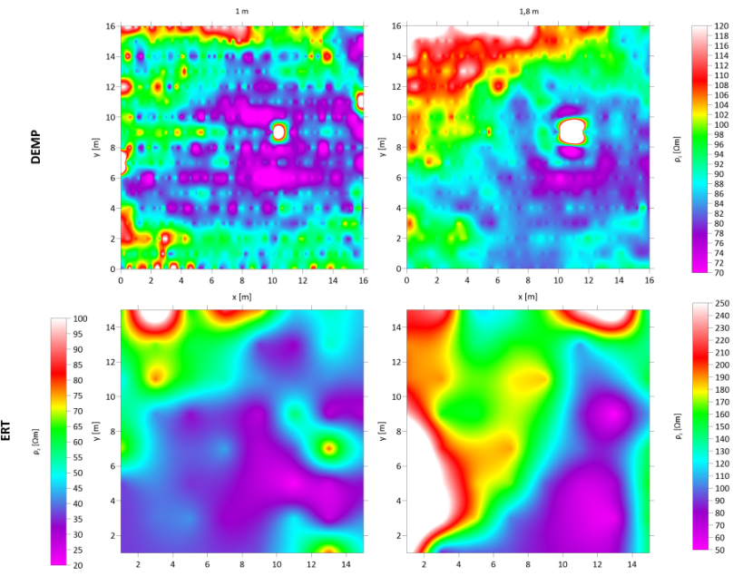
GEOPHYSICAL IMAGING OF ROOT SYSTEMS:
FROM A SINGLE TREE TO FOREST STAND LEVEL
Majewski Robert, Štykar Jan, Valenta Jan, Tábořík Petr, Patočka Zdeněk, Kučera Aleš, Urban Josef, Neubauer Štěpán, Kostka Matěj, Vitásek Roman, Joura Libor, Vokurka Jan, Ehrenbergerová Lenka
THE AIMS OF THE PROJECT
This project evaluates the possibility of using geophysical measurements in modern analyses applicable to forestry practice for the purpose of a more detailed assessment of the influence of vegetation on the physical and chemical properties of the soil. Our aim was to estimate the efficiency of geophysical surveying in forest conditions.
Introduction
Geophysical surveys in forest sites so far have been used mostly for geological survey purposes. However, current trends show that methods such as e.g. electrical resistivity tomography (ERT) and dipole electromagnetic profiling (DEMP) may be successfully and non-invasively utilized for environmental purposes e.g. monitoring of soil water uptake by trees [Cassiani et al. 2015], visualization of root systems and localization of absorption zones [Majewski et al. 2022], detection of root system impact on infrastructure [Hruška et al. 1999] or in developments of new methods and technologies for plant physiological activity monitoring [Aubrecht et al 2006].
Fig. 2: View of the research plot during ongoing pedological soil sampling.
THE METHODS AND MATERIALS
Experimental sites
The research plots are located in the forest stands of the University enterprise Masaryk Forest in Křtiny. Four 16x16m research plots of 40, 60, and 123 years, and uneven-aged European beech were selected. The geodesic grid of 1x1 m was established on each site allowing soil sample excavation
Geophysical surveys
Geophysical surveys of ERT and EMI were run at all four forest sites. Electrical resistivity tomography was performed using ARES II resistivity meter (GF Instruments, Czech Republic) and dipole electromagnetic profiling CMD MiniExplorer instrument (GF Instruments, Czech Republic).
site imagining
Terrestrial close-range photogrammetric data was taken for each plot and processed into the form of point clouds, digital surface models, and orthophotos. Point clouds of the entire area including trees were captured by Faro Focus 3D terrestrial laser scanner. The resulting point clouds will be used to derive tree positions, DBH, heights, and other forest or canopy variables.
ROOT SYSTEM AIR UNCOVERING
To verify ERT and EMI efficiency, root systems excavation was performed using a model 150/90 Air-Spade (Concept Engineering Group, Inc. Verona, PA, USA) and compressor.
RESULTS
GEOPHYSICAL SURVEYING
ERT and DEMP provided resistivity distribution maps on European beech sites for varying depths [Fig. 2].
SITE IMAGINNING
Fig. 2: Depth slices of resistivity distribution by ERT and EMI in 123-year-old European Beech site.
Fig. 3: 3D model derived from close-range photogrammetry.
REFERENCES
Aubrecht, L., Staněk, Z., Koller, J., (2006), Electrical measurement of the absorption surfaces of tree roots by the earth impedance method: 1. Theory, Tree Physiology 26, 1105–1112
Cassiani, G., Boaga, J., Vanella, D., Perri, MT., Consoli, S., (2015) Monitoring and modelling of soil–plant interactions: the joint use of ERT, sap flow and eddy covariance data to characterize the volume of an orange tree root zone. Hydrology and Earth System Sciences 19:2213-2225
Hruška, J., Čermák, J, Šustek, S., (1999). Mapping tree root systems with ground-penetrating radar, Tree physiology, 19(2), 125-130
Majewski, R.S., Valenta, J., Tábořík, P., et al. (2022) Geophysical imaging of tree root absorption and conduction zones under field conditions: a comparison of common geoelectrical methods. Plant Soil 481, 447–473
ACKNOWLEDGEMENT
The project IGA-FFWT-23-TP-010 was supported by the Specific University Research Fund MENDELU.
https://www.ldf.mendelu.cz/

