Slide 1
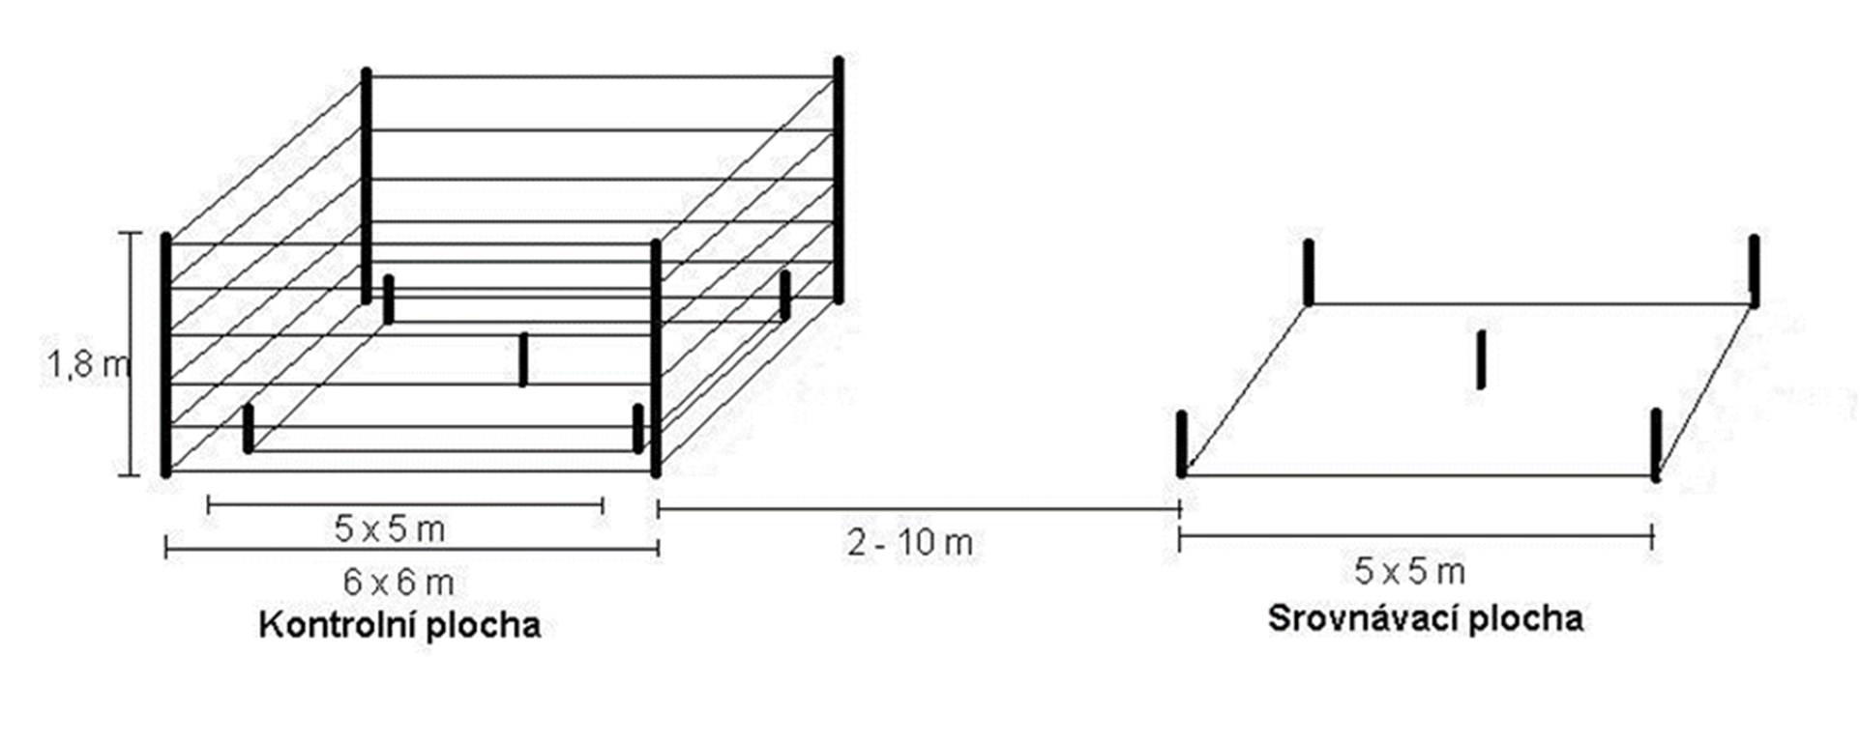
DENSITY ESTIMATION OF RED DEER POPULATION AND THE IMPACT TO TREE NATURAL REGENERATION
Plhal Radim¹, Turek Kamil² a Peška Pavel³
1) Department of Forest Protection and Wildlife Management, Faculty of Forestry and Wood Technology, Mendel University in Brno
2) Forest Management Institute in Brandýs nad Labem, branch office Frýdek-Místek
3) Department of Forest Botany, Dendrology and Geobiocoenology, Faculty of Forestry and Wood Technology, Mendel University in Brno
Why to use Random Encounter model (REM)?
Individual identification is not necesary. Lower level of stress for individuals in the study area.
Data acquisition for the REM method is very inexpensive in terms of equipment and time.
The method is validated and widely used, our results can be compared with those of other researchers.
INTRODUCTION
RESULTS
The environment of National Park Bohemian Switzerland (NP) has long been under considerable pressure from herbivorous animals. In 2022, it was decided to prepare a study with the aim of determining the estimate of the number of herbivorous animals with an emphasis on deer. The aim of the study was also to assess its influence on the current forest regeneration and the proposal of hunting management for the next period. From June 2022, NP has been continuously monitoring wildlife using camera traps. The method of using a network of photo traps was chosen as the most effective way of obtaining data needed not only for estimating the number of herbivorous species present, but also as a source of information about other animal species. The Random Encounter Model (REM) method was used to estimate the population density of particular game species. This method is currently considered one of the most accurate and is internationally recognized as a comparative method.
The estimate of the number of deer in the years 2022 and 2023 was 549 and 474 respectively in the territory of the entire area of the park - i.e. approximately (69 and 59/1000ha respectively). According to this estimate, the standardized levels are thus exceeded 2-3 times. The distribution of deer game in the NP is uneven due to seasonal changes with regard to the use of food resources in the NP territory and its surroundings.
The estimate of the number of deer in the years 2022 and 2023 was 549 and 474 respectively in the territory of the entire area of the park - i.e. approximately (69 and 59/1000ha respectively). According to this estimate, the standardized levels are thus exceeded 2-3 times. The distribution of deer game in the NP is uneven due to seasonal changes with regard to the use of food resources in the NP territory and its surroundings.
METHODOLOGY
INTENSITY OF BROWSING ON FOREST TREES SPECIES
In order to obtain data suitable for this method, a network of 37 photo traps was created in the NP and the surrounding area with a mutual distance of approx. 1.3 km. Camera traps were installed as standard according to the manufacturer's instructions. The regularly obtained photographs were further analyzed and from the obtained data, estimates of the abundance of mainly red deer in 2022 and 2023 were calculated.
The method of control and comparison areas (KSP) (Fig.1) was used to analyze the state of forest regeneration damage. The establishment, maintenance, control and registration of results from the KSP are governed by the currently valid legislation. During field investigations, already established (according to Decree No. 101/1996 Coll. and Methodical Instruction of the Ministry of Agriculture No. 14/1996) KSP are evaluated. Here are all the rules for placing, building and evaluating damage on the KSP. Due to the fact that the density of KSP and their current state did not allow obtaining a sufficient amount of the necessary data, the KSP network was supplemented with a network of monitoring areas.
Fig. 2: Proportion (%) of trees with current main shoot damage by herbivores with interval estimation and critical forest damage level (in red) taken from Switzerland (HB-hornbeam, JV-maple, JR-rowan, DB-oak, JS-ash, BK-beech, BR-birch, BO-pine, SM-spruce, OS-poplar, JD-fir).
From the analysis of data obtained from 40 monitoring areas and 31 control and comparison areas in the NP in 2022, in a total of 71 areas and 2985 trees of 11 tree species, growing in the height category from 0.1 to 1.3 m outside the fence and without applied protection against bite, twice as much (44%) damage to the forest by game was found compared to data from the KSP for the whole of the Czech Republic (19%).
At such a high level of damages to forest regeneration by wild herbibores, attractive species of autochthonous and meliorating or strengthening trees may gradually disappear from the population of trees in the NP. As a result, the stands can once again be species-unified in favor of spruce that is not attractive, but which, however, will probably be damaged by gnawing and peeling of the bark at an older age. This process will cause a considerable deviation from the natural development and, to a certain extent, destabilization of the entire forest complex of the NP.
control area
comparison area
Fig. 1: Design of control and comparison areas (KSP).
ACKNOWLEDGEMENT
This study was supported with funding provided by the Internal Grant Agency (IGA) project ‘IGA-LDF22TP2-107‘ of the Faculty of Forestry and Wood Technology, Mendel University in Brno.
https://www.ldf.mendelu.cz/

