Slide 1
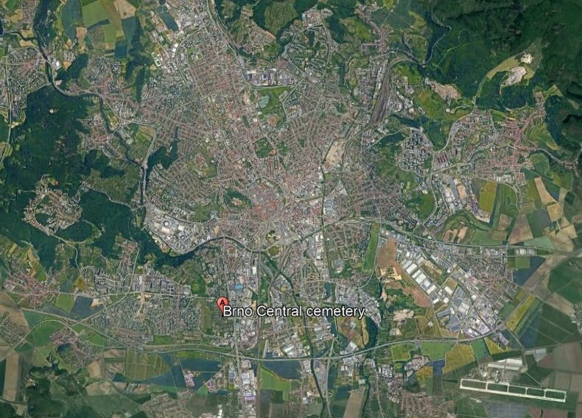
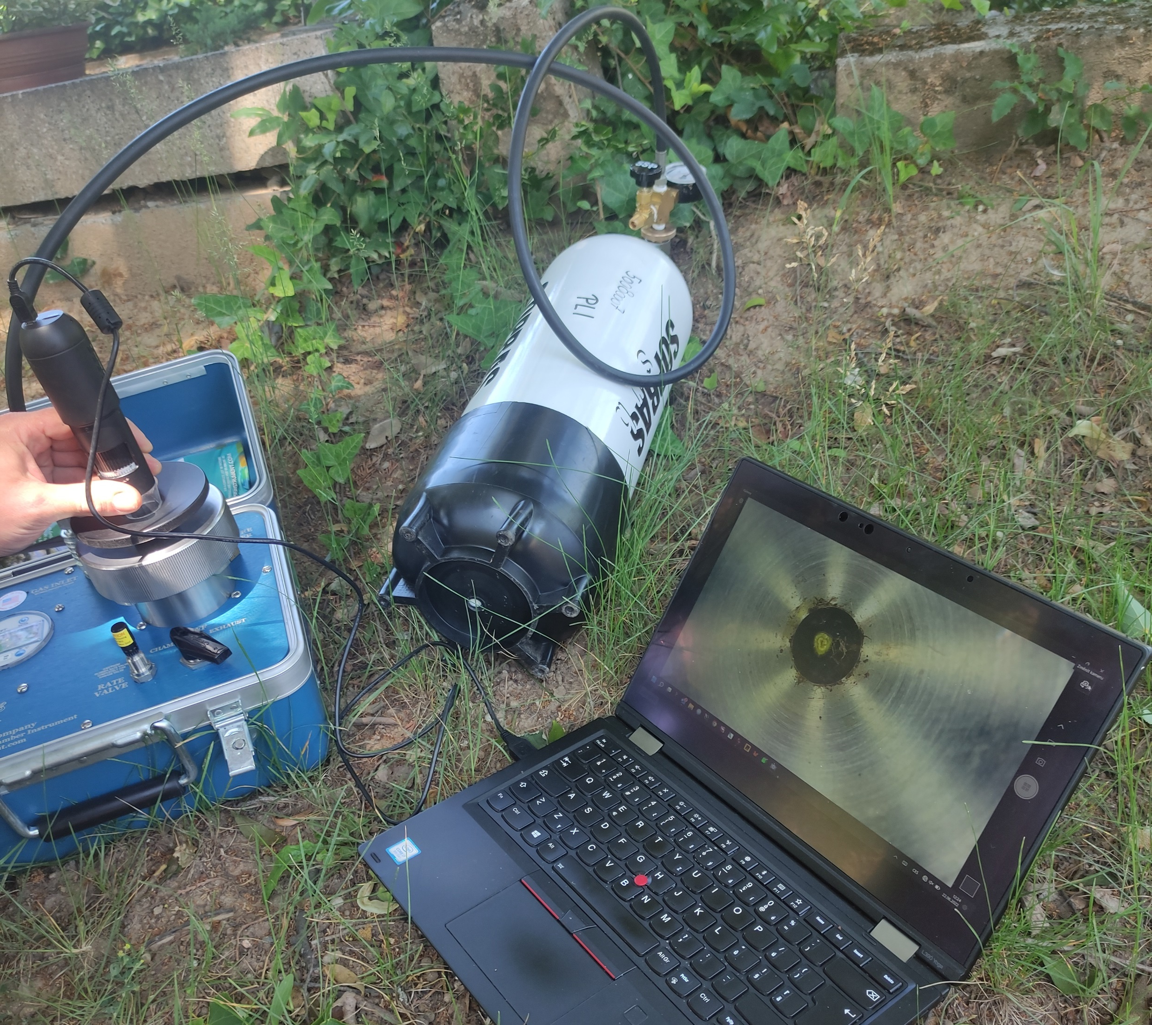
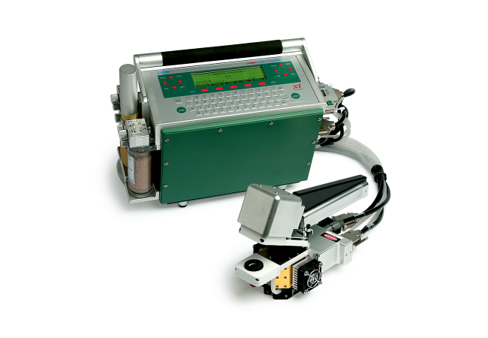
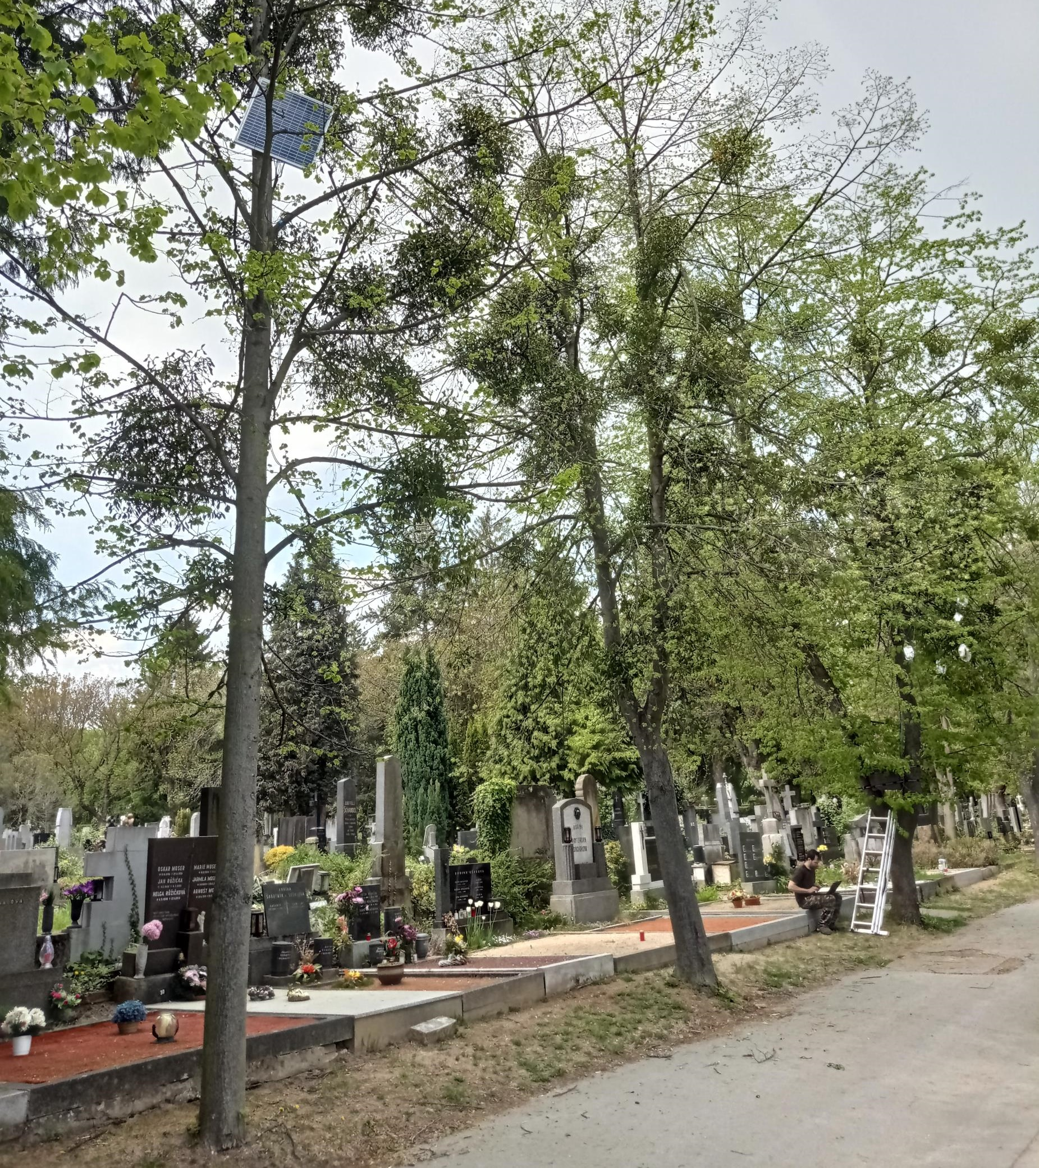
Methods
Water relations of mistletoe Viscum album L. and its host Tilia cordata Mill.
Keawaree Dulnakij, Tatiana Nikitina, Roman Vitásek, Roman Plichta
Mendel University in Brno, Faculty of Forestry and Wood Technology, Brno, Czech Republic
Introduction
Water plays an important role in the life of trees. Lack of water can lead to stress, wilting, reduced growth, increased vulnerability to diseases and pests, root damage, and in extreme cases, tree mortality. European mistletoe (Viscum album L.) is a hemi-parasitic shrub that taps the xylem of its host via haustoria. It is hypothesized that Viscum is not regulating its transpiration and significantly decreases water potential of the host species to adverse levels. In our study, we assessed the water relations between Viscum and its host linden (Tilia cordata Mill.) during growing season.
The leaf water potential and leaf gas exchange was repeatedly measured on highly infested, non-infested Tilia trees and Viscum from 9:30 a.m. to 5:30 p.m. during warm and sunny days of summer 2023. Daily course and linear regressions fitted by mixed models were assessed.
Experimental site on the Brno city cemetery, Czech Republic
Leaf water potential using Scholander pressure chamber (PMS 1505D-EXP)
Leaf gas exchange using LI-COR 6400
Results
a
e
Viscum maintained the lowest leaf water potential (WP, −2.3±0.3 MPa) contrary to infested Tilia (-1.8±0.2 MPa) and non-infested Tilia (-1.6±0.1 MPa) (a). Both non-infested Tilia and Viscum showed increase in WP during noon (a).
Decrease in stomatal conductance (g_{s}) during noon showed both Viscum and non-infested Tilia contrary to infested Tilia, which closed and remained stomata closed right before and after noon (b).
The pattern of g_{s} (b) was reflected in net photosynthesis (A_{net}) (c) as well as in transpiration (E) (d), where Viscum showed the lowest A_{net} (C) but the highest E (d) referring to low water use efficiency (WUE).
The infestation changed all relations of Tilia leaves (E, F, H) except of A_{net} to g_{s} ratio (G).
Leaf temperature (T_{leaf}) was the best predictor of g_{s} for all three tested groups (F), while WP was also the predictor of g_{s} for non-infested Tilia (E).
The only Viscum increased E with increase in air temperature (T_{air}) (H).
b
f
c
g
d
h
Conclusions
Viscum showed strong effect on host Tilia, which was forced to close stomata and limit carbon sequestration without substantial decrease in water potential.
Not water potential, but leaf temperature was the best predictor of stomatal conductance in Viscum, and both infested and non̵˗infested Tilia.
Tilia is strongly isohydric species.
The effect of carbon starvation of host tree should be studied in future.
Acknowledgement The research was financed by Internal Grant Agency MENDELU reg. IGA-LDF-22-TP-007
https://www.ldf.mendelu.cz/

