Slide 1
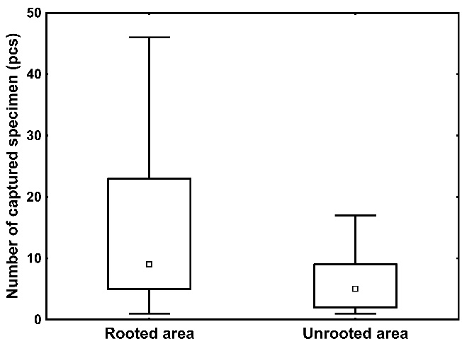
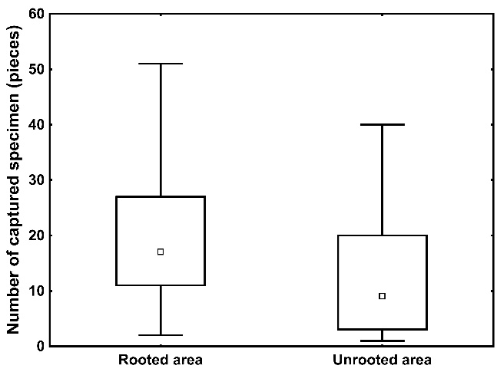
IMPACT OF ROOTING OF WILD BOAR (SUS SCROFA L.) ON ARTHROPODA
Špoula Jakub, Drimaj Jakub, Mikulka Ondřej, Růžičková Eliška
Department of Forest Protection and Wildlife Management, Faculty of Forestry and Wood Technology, Mendel University in Brno
INTRODUCTION
METHODOLOGY
Wild boar (Sus scrofa) is mammal native to Eurasia [6], but now it is present in all continents except Antarctica [5]. The increased population of wild boar has several negative economic impacts (e. g. rooting of tree seedlings and agricultural crops) [7; 1]. Impacts of rooting on epigeic invertebrates were studied by a few authors (e. g. [3]), but no author has studied effects of rooting on invertebrates in oak forests. Our goal was to evaluate effects of wild boar rooting on most abundant epigeic invertebrates.
In 2022 and 2022, on 10 model localities 50 pitfall traps were placed to compare epigeic communities on areas affected by wild boar rooting (5 areas, 25 traps) and area with no rooting (5 areas, 25 traps). The pitfall traps were filled with 4 % solution of chloroform and the samples were collected every month during the growing season from July 2022 to September 2023. The samples were preserved in 75 % solution of ethanol. In the laboratory, the samples were divided into taxonomic groups. Only endangered species, Elateridae, Carabidae and Geotrupidae were identified into species. The normality of data was analyzed by Shapiro–Wilk test and differences between pitfall traps were test by Mann–Whitney U test.
RESULTS
In total, 12 180 arthropods were captured in pitfall traps. Our results indicate, that familiae Elateridae, Geotrupidae, Gryllidae, Staphylinidae and Phalangiidae were not affected by rooting (p > 0.05). Araneae (p = 0.000007) (Fig. 1), Diplopoda (p = 0.0008) (Fig. 2) and Carabidae (p = 0.009) were more active in areas with rooting.
Totally 919 specimens of Carabidae were captured. Totally 11 species Carabidae were active in model localities. Most abundant species was Harpalus rufipes De Geer (Tab. 1).
During this study, Licinus depressus Paykull was recorded for the first time in Hodonín district. Licinus depressus is xerophilous ground beetle that is found in dry, sandy or gravelly soils sites in grasslands, on overgrown dunes, and in dry forests [2]. During the study, two endangered species of Red list of Threatened Species of Czech republic: Invertebrates [4] Cucujus cinnaberinus Scopoli and Selatosomus cruciatus L. were present in unrooted areas.
Our results indicate that epigeic insect predators are more abundant in rooted areas by wild boar, which leads to perturbation of forest soil and subsequential attraction of ground predators (Araneae, Carabidae and Diplopoda).
Fig. 1: Numbers of specimens of Araneae in
pitfall traps
Fig. 2: Numbers of specimens of Diplopoda in
pitfall traps
Tab. 1: : Carabidae species captured in pitfall traps
ACKNOWLEDGEMENT
This study was supported with funding provided by the Internal Grant Agency (IGA) project ‘IGA-LDF-22-TP-006‘ of the Faculty of Forestry and Wood Technology, Mendel University in Brno.
REFERENCES
[1] Anderson, A., Slootmaker, C., Harper, E., Holderieath, J., Shwiff, S.A. 2016. Economic estimates of feral swine damage and control in 11 US states. Crop Protection, 89, 89–94.
[2] Baur, B., Gilgado, J.D., Coray, A. 2023. Prey handling and feeding habits of the snail predator Licinus depressus (Coleoptera, Carabidae). Alpine Entomology, 7, 63–68.
[3] Fagiani, S., Fipaldini, D., Santarelli, L. et al. 2014. Monitoring protocols for the evaluation of the impact of wild boar (Sus scrofa) rooting on plants and animals in forest ecosystems. Hystrix, 25(1), 31–38.
[4] Hejda, R., Farkač, J., Chobot, K. 2017. Red list of Threatened Species of Czech Republic: Invertebrates. Prague: Nature Conservation Agency of the Czech Republic, 760 pp.
[5] Long, J.L. 2003. Introduced Mammals of the World: their History, Distribution and Abundance. Journal of Mammalogy, 85(2), 363.
[6] Massei, G., Genov, P.V. 2004. The environmental impact of wild boar. Galemys Spanish Journal of Mammalogy, 16(1), 135–145.
[7] Mayer, J. 2009. Wild pig damage: overview of wild pig damage. In: Mayer, J., Brisbin, I.L. Jr. (eds) Wild pigs: biology, damage, control techniques and
management. Aiken: Savannah River National Laboratory, 221–246.
https://www.ldf.mendelu.cz/

